Slide 1

KEYSTROKE LOGGING DEMONSTRATION- KEYSTROKE LOGGER
BY
PRIYADARSHINY DAS
Techno Main Salt Lake
B.Tech in Computer Science And Engineering- Cyber Security (2024-2028)
12/10/2025
Annual Review
‹#›

Slide 2

PROBLEM STATEMENT
Nowadays, for children’s safety, it is very important for parents to monitor the activities of their children on laptops or other electronic devices. This task becomes especially difficult when multiple applications (like games, homework apps, and web browsers) are being used. There is a need for a simple, non-invasive method to reliably capture and record everything typed on the computer, including search terms, usernames, and messages, regardless of which screen or program is active, in order to keep track of a child’s activity (online/offline) after a session has ended. Without a record, user activities cannot be monitored, which leaves a significant blind spot regarding the safety and appropriateness of children's interactions.
12/10/2025
Annual Review
‹#›

Slide 3
Project Description
This project is a functional keystroke logger that captures all keyboard inputs across the operating system into a single, comprehensive log. It utilizes a simple web interface to provide user control, allowing the logging process to be cleanly started and stopped. Upon termination, the entire sequence of recorded characters and special keypresses is displayed, providing a complete audit trail of user activity during the session.
LOGIC AND ALGORITHMS
  Event-Driven Programming: The entire application logic hinges on reacting to system-level events (key presses).
  Listener/Callback Model: The pynput.keyboard.Listener runs continuously in the background, waiting for a hardware event. The on_press() callback function is executed every time a key is pressed.
  Global State Management: A class (KeyloggerState) is used to maintain the program's critical data, specifically the log_string that accumulates all recorded input. A simple string concatenation is performed within the on_press handler: self.log_string += char.
  Concurrency/Threading: The resource-intensive pynput listener must run simultaneously with the Gradio web server without blocking it. The listener is executed within a separate, non-blocking threading.Thread (start_listener_thread) and controlled via a shared boolean flag (logging_active).
  Thread Synchronization: To prevent data corruption when the main thread (Gradio) reads the log while the listener thread is writing to it, access must be synchronized. A threading.Lock is used to ensure only one thread can modify or read the log_string at any given moment.
12/10/2025
Annual Review
‹#›

Slide 4

WHO ARE THE END USERS?
POTENTIAL END USERS
1. Home and Family Users (Parental Monitoring): To ensure the safety of minors online by capturing search queries, chat conversations, and social media inputs. They are looking for a simple, non-technical way to review the activity that occurred on the device.
2. Cybersecurity Students and Educators: To understand how logging utilities work, how to capture raw system input, and how to defend against such tools.
3. Small Business Owners / IT Administrators (Auditing): To perform internal auditing of actions on company-owned machines to ensure compliance with security policies (e.g., verifying that employees are not typing credentials into public websites).
4. Self-Auditors and Developers: To track time spent typing, audit keystroke counts for productivity analysis, or recover lost work (like an un-saved note or snippet of code).
12/10/2025
Annual Review
‹#›

Slide 5

Technology Used
TECHNOLOGIES AND LANGUAGES
  Python: Python is the main execution language. It handles all the backend logic, data processing (string concatenation, logging), state management, threading, and is the environment in which all the libraries run.
  pynput (Python library): The essential component. It provides the low-level keyboard listener algorithm that captures global keystrokes across the operating system, regardless of the active application.
  threading (Python library): Used for concurrency. It ensures the key listener can run continuously in the background at the same time as the Gradio web server is active, preventing the interface from freezing.
  Gradio (Python library): Provides the web-based user interface (UI). It allows the Python functions (like start_logging and stop_logging) to be triggered by simple buttons in a browser window.
  System-level monitoring: The keylogger's purpose is to monitor inputs globally across the operating system (desktop, other applications, terminal).
  Server-side execution: The Python script, including the pynput listener, runs entirely on the local machine's operating system (the server).
APPLICATION TYPE: Desktop application.
12/10/2025
Annual Review
‹#›
Notes:
5

Slide 6
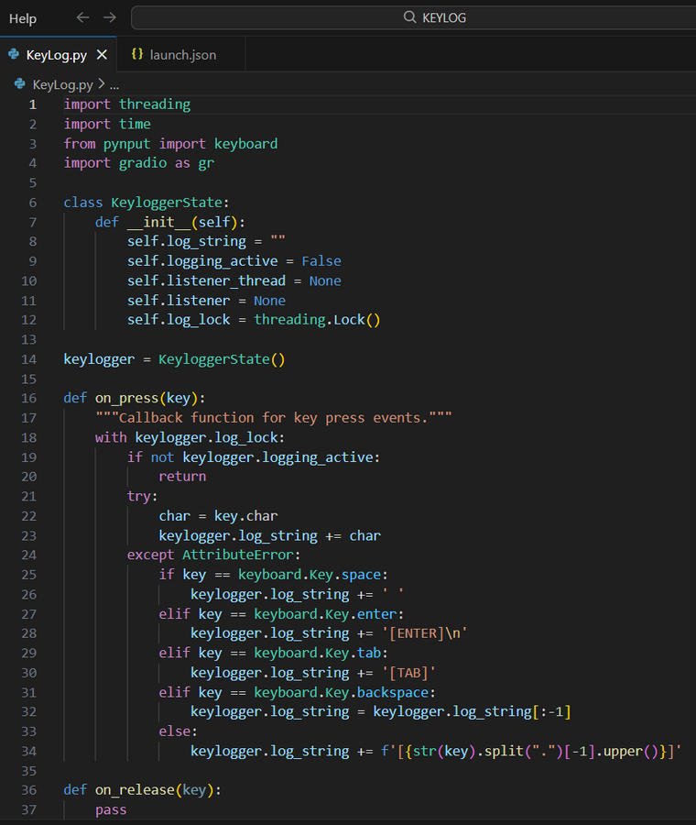
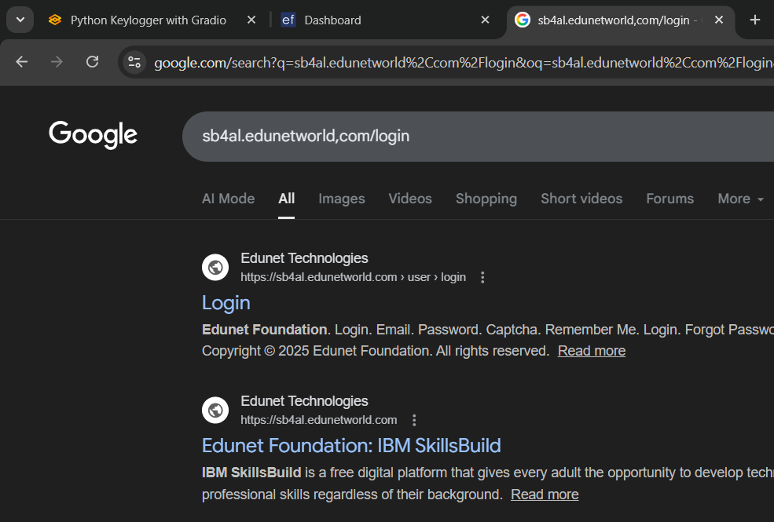
RESULTS
GitHub Link: https://github.com/PERSONAL-PROJECTS-2000/KEYLOG.git
12/10/2025
Annual Review
‹#›

Slide 7
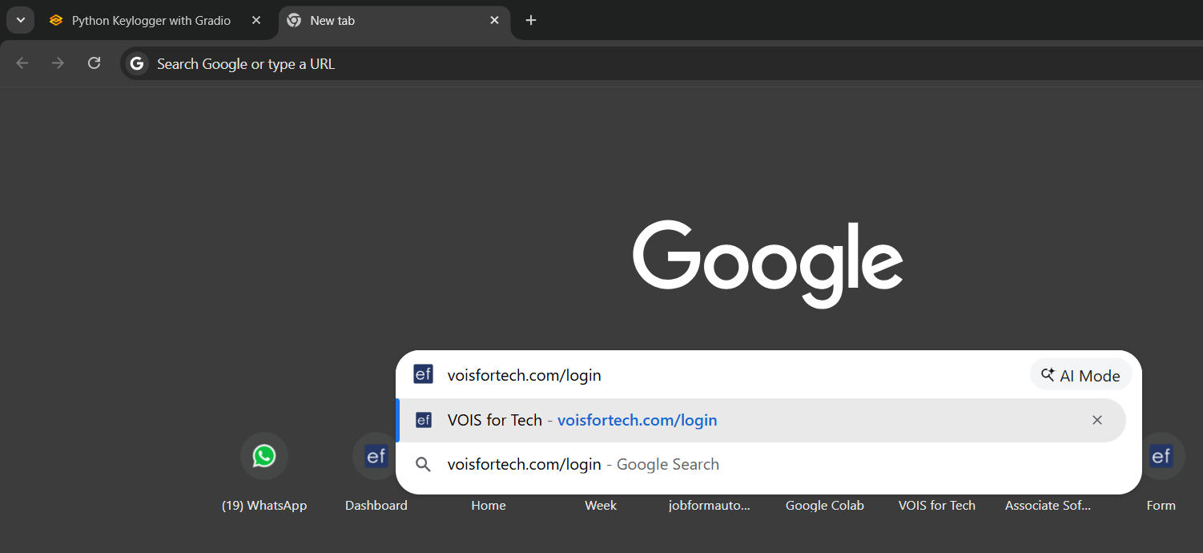
12/10/2025
Annual Review
‹#›

Slide 8
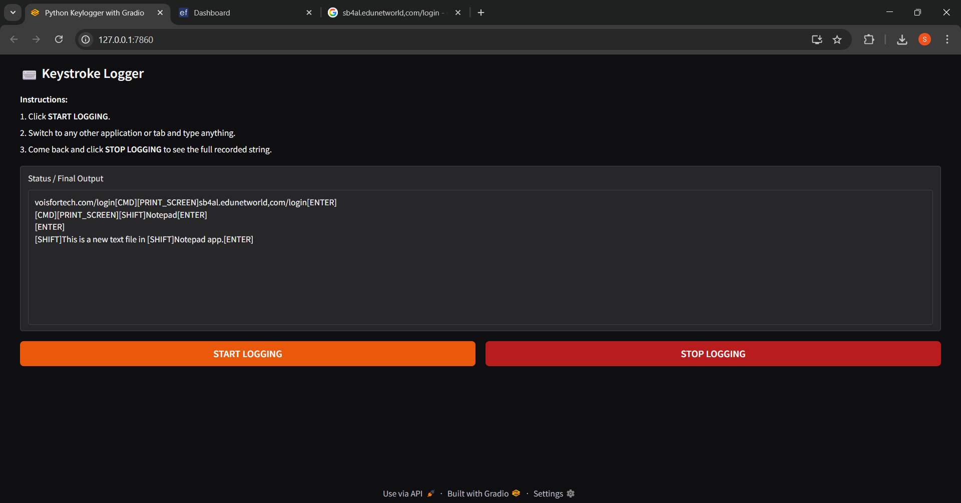
12/10/2025
Annual Review
‹#›

Slide 9
Thank you
.
.
12/10/2025
Annual Review
‹#›

